Slide 1

Massivlar

Slide 2
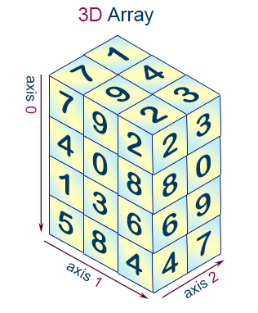
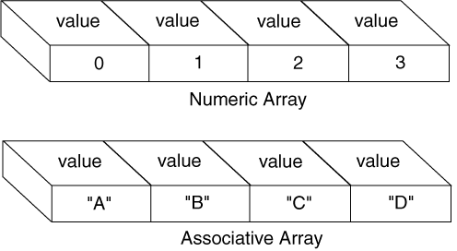
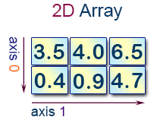
Massivlar
Massiv turlari:
Nomerlangan massiv (Numeric or indexed array)
Assotsiativ massiv (Associative Array)
Ko'p o'lchovli massiv (Multidimensional Array)

Slide 3
Massivlar
Sintaksisi: array(
key1 => value1,
key2 => value2,
key3 => value3,
...
)
Kalit sifatida int yoki string turidagi qiymat ishlatiladi.
[
key1 => value1,
key2 => value2,
key3 => value3,
...
]
<?php $array = array( "foo" => "bar", "bar" => "foo", );
$array = [ "foo" => "bar", "bar" => "foo", ]; ?>

Slide 4
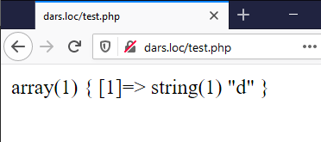
Massivlar
Kalit bilan quyidagi o'zgarishlar amalga oshiriladi:
butun son saqlovchi satrlar int turiga almashtiriladi, masalan, "8" kaliti 8 qiymat orqali saqlanadi. Lekin "08" satri butun songa o'girilmaydi, chunki bu to'g'ri o'nlik s.s. son emas.
suzuvchi nuqtali sonlar (float) int turiga almashtiriladi (haqiqiy qismi olib tashlanadi, 8.7 -> 8)
mantiqiy (bool) turdagi qiymatlar int turiga almashtiriladi.
null turi bo'sh satrga almashtiriladi (null -> "")
<?php
$array = array(
1 => "a",
"1" => "b",
1.5 => "c",
true => "d",
);
var_dump($array);

Slide 5
Massivlar
Massiv e'lonida kalitlar turi aralash bo'lishi mumkin, shuningdek kalit ishlatilmasligi ham mumkin.
<?php
$array = array(
"foo" => "bar",
"bar" => "foo",
100 => -100,
-100 => 100,
);
var_dump($array);
$array = array("foo", "bar", "hello", "world");
var_dump($array);
array(4) {
["foo"]=>
string(3) "bar"
["bar"]=>
string(3) "foo"
[100]=>
int(-100)
[-100]=>
int(100)
}
array(4) {
[0]=>
string(3) "foo"
[1]=>
string(3) "bar"
[2]=>
string(5) "hello"
[3]=>
string(5) "world"
}

Slide 6
Massivlar
Massiv elementlariga murojaat array[key] sintaksisi orqali amalga oshiriladi.
<?php
$array = array(
"foo" => "bar",
42 => 24,
"multi" => array(
"dimensional" => array(
"array" => "foo"
)
)
);
var_dump($array["foo"]);
var_dump($array[42]);
var_dump($array["multi"]["dimensional"]["array"]);
string(3) "bar"
int(24)
string(3) "foo"

Slide 7
Massivlar
array[key] = value sintaksisi orqali massiv elementlarini o'zgartirish mumkin. Agar key tushurib qoldirilsa yoki mavjud bo'lmagan kalit bo'lsa massivga yangi element qo'shiladi.
<?php
$arr = array(5 => 1, 12 => 2);
$arr[5] = 13;
var_dump($arr);
$arr[] = 56;
var_dump($arr);
$arr["x"] = 42;
var_dump($arr);
array(2) {
[5]=>
int(13)
[12]=>
int(2)
}
array(3) {
[5]=>
int(13)
[12]=>
int(2)
[13]=>
int(56)
}
array(4) {
[5]=>
int(13)
[12]=>
int(2)
[13]=>
int(56)
["x"]=>
int(42)
}

Slide 8
Massivlar (foydali funksiyalar)
Massivga element qo'shish yoki massivdan element o'chirish bilan bog'liq quyidagi funksiyalarni ishlatish mumkin:
array_pop() – massivdan oxirgi elementni olish (massivdan ushbu element o'chiriladi)
array_push() – massiv oxiriga element yoki bir nechta elementlarni joylash
array_shift() – massivdan birinchi elementni olish (massivdan ushbu element o'chiriladi)
array_unshift() – massiv boshiga element yoki bir nechta elementlarni joylash

Slide 9
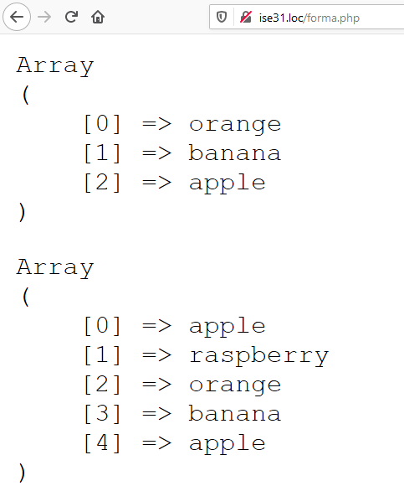
Massivlar (foydali funksiyalar)
<?php
$stack = array("orange", "banana", "apple", "raspberry");
$fruit = array_pop($stack);
echo "<pre>";
print_r($stack);
echo "</pre>";
array_unshift($stack, "apple", "raspberry");
echo "<pre>";
print_r($stack);
echo "</pre>";

Slide 10
Massivlar (foydali funksiyalar)
unset() – massivni yoki massiv elementini o'chirish (ixtiyoriy o'zgaruvchini o'chirish)
sort() – massivni tartiblash (o'sish, kalitlar qayta aniqlanadi)
asort() – massivni tartiblash (o'sish, kalitlarni saqlagan holda)
rsort() – massivni tartiblash (kamayish, kalitlar qayta aniqlanadi)
arsort() – massivni tartiblash (kamayish, kalitlarni saqlagan holda)
shuffle() – massiv elementlarini o'rnini ixtiyoriy tartibda almashtirish
array_rand() – massivdan bir yoki bir nechta ixtiyoriy elementni tanlab oladi va ularning kalitini qaytaradi sintaksisi: array_rand(array $array, int $num = 1)
array_values() – indekslarni qayta taqsimlash
array_filter() – massiv elementlarini callback-funksiya orqali filtrlash
array_map() – callback-funksiyani massivning har bir elementiga qo'llash va yangi massiv hosil qilish
array_walk() – callback-funksiyani massivning har bir elementiga qo'llash
array_reduce() – callback-funksiya orqali massivning elementlarini kamaytirib natija olish

Slide 11
Massivlar (foydali funksiyalar)
Array
(
[0] => 1
[1] => 2
[2] => 3
[3] => 4
[4] => 5
[5] => 6
[6] => 7
[7] => 8
[8] => 9
[9] => 10
)
Array
(
[0] => 1
[2] => 3
[4] => 5
[6] => 7
[8] => 9
)
Array
(
[0] => 1
[2] => 3
[4] => 5
[6] => 7
[8] => 9
[10] => 6
[a2] => 2
[a13] => 13
)
Array
(
[0] => 1
[1] => 3
[2] => 5
[3] => 7
[4] => 9
[5] => 6
[6] => 2
[7] => 13
)
<?php
$array = array(1, 2, 3, 4, 5, 6, 7, 8, 9, 10);
print_r($array);
foreach ($array as $i => $value) {
if ($array[$i] % 2 == 0) unset($array[$i]);
}
print_r($array);
$array[] = 6;
$array["a2"] = 2;
$array["a13"] = 13;
print_r($array);
$array = array_values($array);
print_r($array);

Slide 12
Massivlar (foydali funksiyalar)
<?php
$array = range(1, 10);
shuffle($array);
print_r($array);
asort($array);
print_r($array);
sort($array);
print_r($array);
$rand_keys = array_rand($array, 4);
print_r($rand_keys);
Array
(
[0] => 5
[1] => 7
[2] => 8
[3] => 4
[4] => 3
[5] => 1
[6] => 10
[7] => 2
[8] => 9
[9] => 6
)
Array
(
[5] => 1
[7] => 2
[4] => 3
[3] => 4
[0] => 5
[9] => 6
[1] => 7
[2] => 8
[8] => 9
[6] => 10
)
Array
(
[0] => 1
[1] => 2
[2] => 3
[3] => 4
[4] => 5
[5] => 6
[6] => 7
[7] => 8
[8] => 9
[9] => 10
)
Array
(
[0] => 2
[1] => 3
[2] => 4
[3] => 5
)

Slide 13
Massivlar (foydali funksiyalar)
Sintaksisi: array_filter( array $array, callable|null $callback = null, int $mode = 0) : array
<?php
function odd($var) {
return $var & 1;
} function even($var) {
return !($var & 1);
}
$array1 = ['a' => 1, 'b' => 2, 'c' => 3, 'd' => 4, 'e' => 5];
$array2 = [6, 7, 8, 9, 10, 11, 12];
echo "Toq sonlar:\n";
print_r(array_filter($array1, "odd"));
echo "Juft sonlar:\n";
print_r(array_filter($array2, "even"));
Toq sonlar:
Array
(
[a] => 1
[c] => 3
[e] => 5
)
Juft sonlar:
Array
(
[0] => 6
[2] => 8
[4] => 10
[6] => 12
)

Slide 14
Massivlar (foydali funksiyalar)
array_filter funksiyasida $mode argumentini ishlatishda quyidagi oldindan aniqlangan konstantalardan foydalanish mumkin:
ARRAY_FILTER_USE_KEY – callback-funksiyaga faqat kalitni jo'natish ARRAY_FILTER_USE_BOTH – callback-funksiyaga faqat kalit va qiymatni jo'natish
<?php
$array = ['a' => 1, 'b' => 2, 'c' => 3, 'd' => 4, 'e' => 5];
print_r(array_filter($array, function ($k) {
return $k == 'a' || $k == 'd';
}, ARRAY_FILTER_USE_KEY));
print_r(array_filter($array, function ($v, $k) {
return $k == 'c' || !($v & 1);
}, ARRAY_FILTER_USE_BOTH));
Array
(
[a] => 1
[d] => 4
)
Array
(
[b] => 2
[c] => 3
[d] => 4
)

Slide 15
Massivlar (foydali funksiyalar)
Sintaksisi: array_map( callable|null $callback, array $array, array ...$arrays) : array
<?php
function hayvonni_qaytarish($n, $m) {
return "$n: - $m";
}
function massiv_qaytarish($n, $m, $p) {
return ['nomi' => $m, 'ovozi' => $p];
}
$a = [1, 2, 3, 4];
$b = ['kuchuk', 'mushuk', 'echki'];
$c = ['vov', 'myau', 'mee'];
$f1 = array_map('hayvonni_qaytarish', $a, $b, $c);
print_r($f1); $f2 = array_map('massiv_qaytarish', $a, $b, $c);
print_r($f2);
Array (
[0] => 1: - kuchuk
[1] => 2: - mushuk
[2] => 3: - echki
)
Array (
[0] => Array (
[nomi] => kuchuk
[ovozi] => vov
)
[1] => Array (
[nomi] => mushuk
[ovozi] => myau
)
[2] => Array (
[nomi] => echki
[ovozi] => mee
)
)

Slide 16
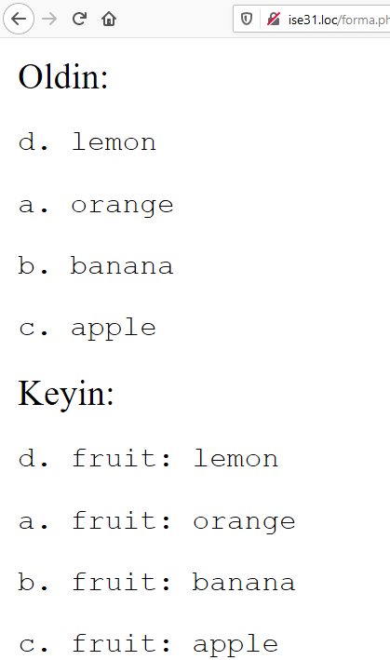
Massivlar (foydali funksiyalar)
Sintaksisi: array_walk( array|object &$array, callable $callback, mixed $userdata = null) : bool
<?php
$fruits = array("d" => "lemon", "a" => "orange", "b" => "banana", "c" => "apple");
function test_alter(&$item1, $key, $prefix)
{
$item1 = "$prefix: $item1";
}
function test_print($item2, $key)
{
echo "<pre>$key. $item2</pre>\n";
}
echo "Oldin:\n";
array_walk($fruits, 'test_print'); array_walk($fruits, 'test_alter', 'fruit');
echo "Keyin:\n"; array_walk($fruits, 'test_print');

Slide 17
Massivlar (foydali funksiyalar)
Sintaksisi: array_reduce( array $array, callable $callback, mixed $initial = null) : mixed callback( mixed $carry, mixed $item) : mixed
<?php
function sum($carry, $item)
{
$carry += $item;
return $carry;
} function mul($carry, $item)
{
$carry *= $item;
return $carry;
}
$a = array(1, 2, 3, 4, 5);
var_dump(array_reduce($a, "sum")); // int(15)
var_dump(array_reduce($a, "mul", 10)); // int(1200), chunki: 10*1*2*3*4*5

Slide 18
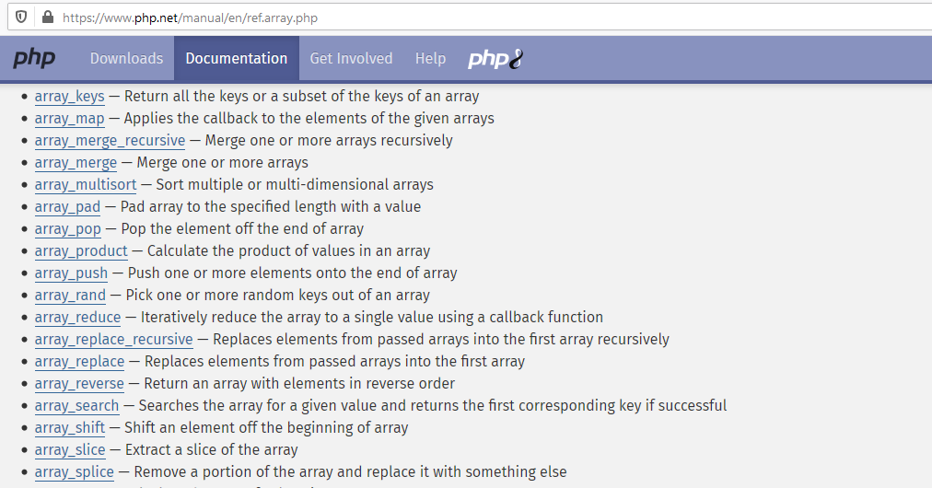
Massivlar (foydali funksiyalar)
Massivlar bilan bog'liq bo'lgan foydali funksiyalarning to'liq ro'yxati bilan quyidagi havola orqali tanishib chiqish mumkin:
https://www.php.net/manual/en/ref.array.php

Slide 19
Savollar?

